Slide 1
Leveraging Crisis Track in a ‘No Notice’ 1,000 Year Flood
2025 Users Conference
Connecticut Department of Emergency Services & Public Protection
Division of Emergency Management & Homeland Security
Ronnell A. Higgins, Commissioner
Brenda M. Bergeron, Deputy Commissioner
William H. Turner III, Director

Slide 2
Connecticut Quick Facts
Constitution State/Nutmeg State
Third smallest state (5018 square miles)
3.6 million residents
29th most populous
4th most densely populated
Best pizza in the country
ESPN
Yale/UCONN
DOD Defense Manufacturing Community

Slide 3
Connecticut Counties

Slide 4
DEMHS Regions

Slide 5
Connecticut Council of Governments

Slide 6
August 18th Weather Briefing

Slide 7
Timeline
On the morning of August 18th, computer modeling was forecasting showers and thunderstorms in western Connecticut that had the potential to deliver 2 – 3 inches of rainfall.
7:00 AM a wide band of heavy showers developed in Southwestern CT. Between 7:00 – 8:00 AM this band of showers moved to the northeast as additional showers developed over western Long Island. Moisture streamed up the New Jersey coast and feed into the developing band of showers and thunderstorms. The band of showers and thunderstorms intensified over Fairfield County from 8:00 to 11:00 AM as rainfall rates exceeded 1” per hour at times.
9:26 AM the National Weather Service Office in Brookhaven issued a Flash Flood Warning for Fairfield and part of New Haven County until 12:30 PM.
10:35 AM DEMHS sent a message to all towns in the state alerting them that 5” of rainfall may occur in Fairfield County by noon.
11:00 AM to 2:00 PM the band continued back building to the southwest as heavy rain moved to the northeast resulting in the training of rainfall over the same areas of central Fairfield and northwest New Haven Counties.

Slide 8
Timeline
2:00 PM rainfall intensities increased significantly in the band, especially from Monroe to Oxford.
2:53 PM NWS Office in Brookhaven issued a Flash Flood Emergency for Fairfield and Northwest New Haven County where 5 inches of rain had already fallen. The extremely heavy rainfall continued from 3:00 PM to 6:30 PM with over 7 inches of additional rain falling in 3 ½ hours from Monroe to Oxford.
Reports of major to catastrophic damage started coming into DEMHS between 4:00 – 5:00 PM.
DEMHS activated a Virtual State Emergency Operations Center (VSOC) at 5:00 PM.
The rainfall tapered off quickly to showers between 6:00 – 7:00 PM.
The total duration of this catastrophic event was 12 hours.

Slide 9
Timeline

Slide 10
Records
24-Hour Rainfall Record: The highest 24-hour rainfall record in Connecticut is 12.77 inches, set in Burlington during Tropical Storm Diane in 1955. Several locations may have exceeded this amount.
1-in-1000 Year Event: Rainfall totals in both Oxford and Southbury have surpassed 10 inches within a 12-hour period. This level of rainfall classifies the event as a 1-in-1000-year flood for these areas.

Slide 13
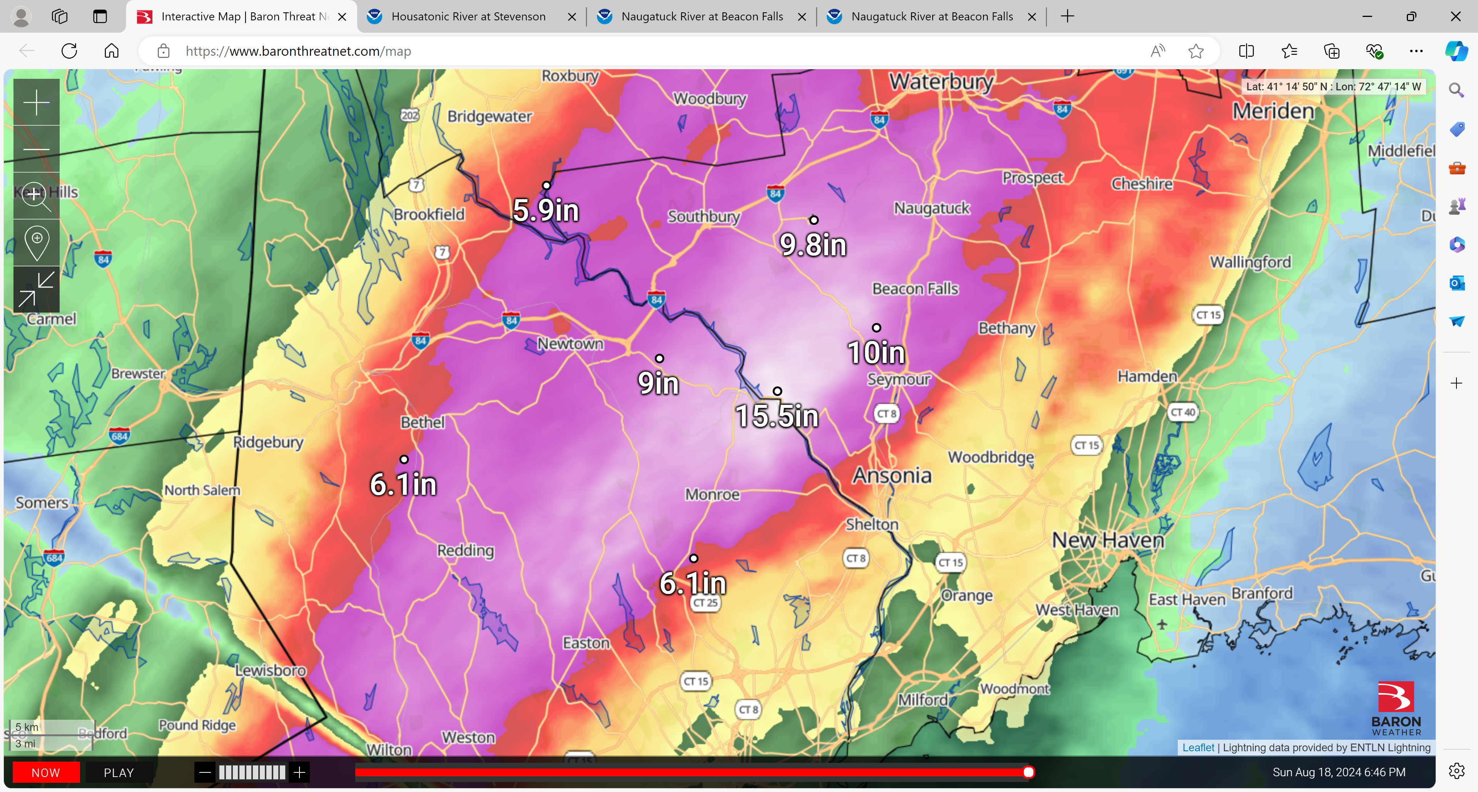
MAP OF RAINFALL INTERVAL
3.99”
1,000+ YR
1,000 YR
500 YR
200 YR
50 YR
100 YR

Slide 14
PEAK RAINFALL RATES…
Peak rainfall rates during yesterday’s severe flooding event exceeded 3.0” inches per hour and 7.0” in three hours in a band from Monroe to Oxford.
The return frequency for this extremely heavy rainfall was greater than 1,000 years.
Southbury
Beacon Falls
Oxford
Monroe

Slide 15
Lessons Learned
Focus on the basics of the system
Don’t overcomplicate training
Commercial data
Importance of tax and parcel data
Sorting through duplicates
Little time organizing on back end can go a long way on the front end

Slide 16
Best Practices
Resident Self Report – Let the public do your windshield survey
Leverage media to promote
Virtual damage verification
Joint PDA
Commercial Data
Real Time Team Tracking
Mobile Application
Data Exports

Slide 17
Resident Self Report

Slide 18
Resident Self Report

Slide 19
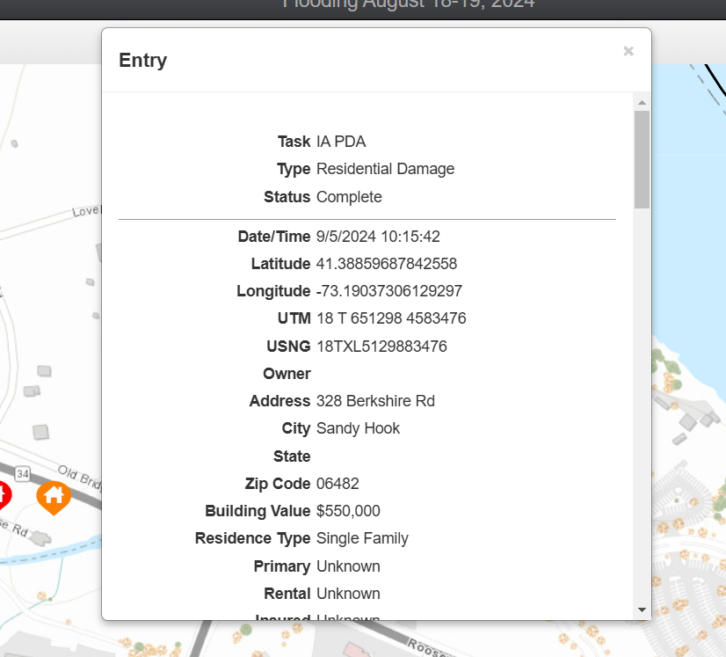
Resident Self Report

Slide 20
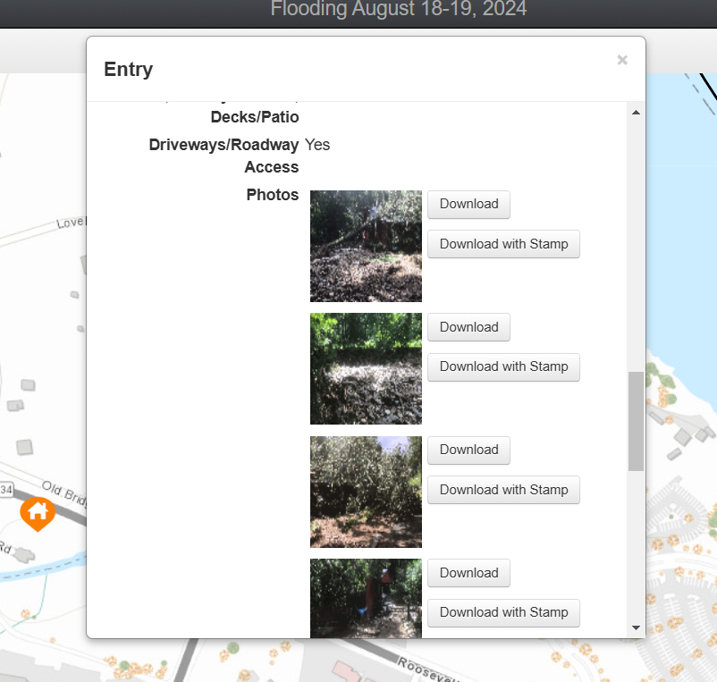
Resident Self Report

Slide 21
Residential Damages

Slide 22
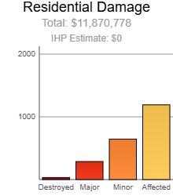
Resident Self Report
1191 Affected
645 Minor
287 Major
32 Destroyed

Slide 23
FEMA Joint PDA Data
Connecticut August IA PDA
Last Updated 9/5/24
County | Status | Destroyed | Major | Minor | Affected | Unaffected | Inaccessible | Total
Fairfield | Complete | 6 | 86 | 237 | 705 | 0 | 30 | 1036
Litchfield | Complete |  | 5 | 33 | 39 | 0 | 9 | 77
New Haven | Complete | 13 | 79 | 345 | 305 | 4 | 94 | 762
Total By Category |  | 19 | 170 | 615 | 1049 | 4 | 133 | 1,990

Slide 24
Declaration Timeline
Joint PDA requested 8/22
Joint PDA started 8/27
Joint PDA concluded 9/6
Disaster Declaration submitted 9/9
Approved 9/20

Slide 25
Commercial Damages

Slide 26
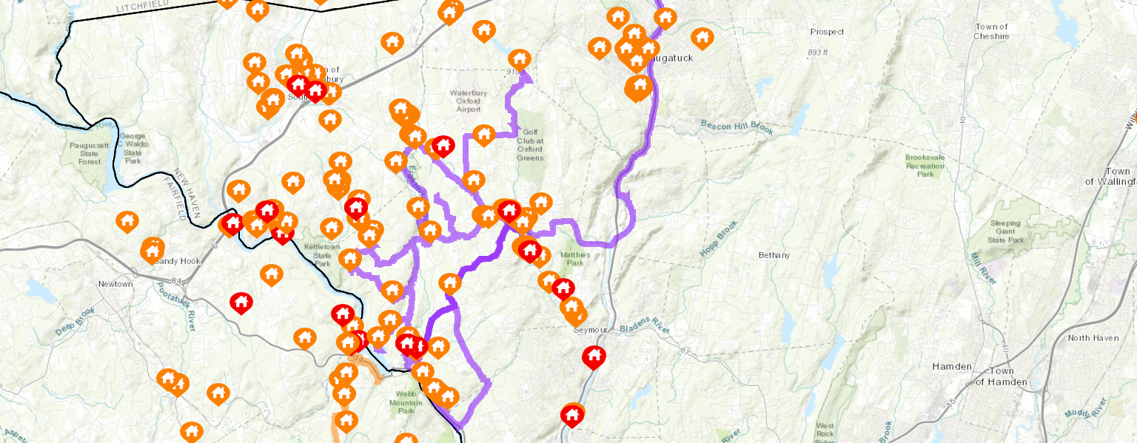
Damage Assessment Team Tracking

Slide 27
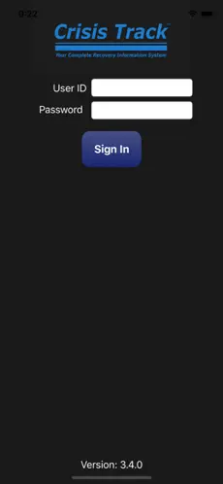
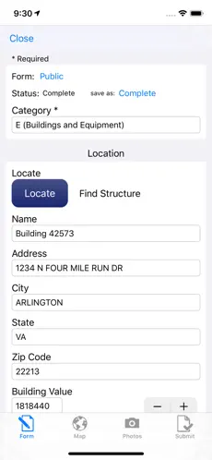
Mobile Application

Slide 28
QUESTIONS
Ronnell A. Higgins, Commissioner
Brenda M. Bergeron, Deputy Commissioner
William H. Turner III, Director

